Slide 1
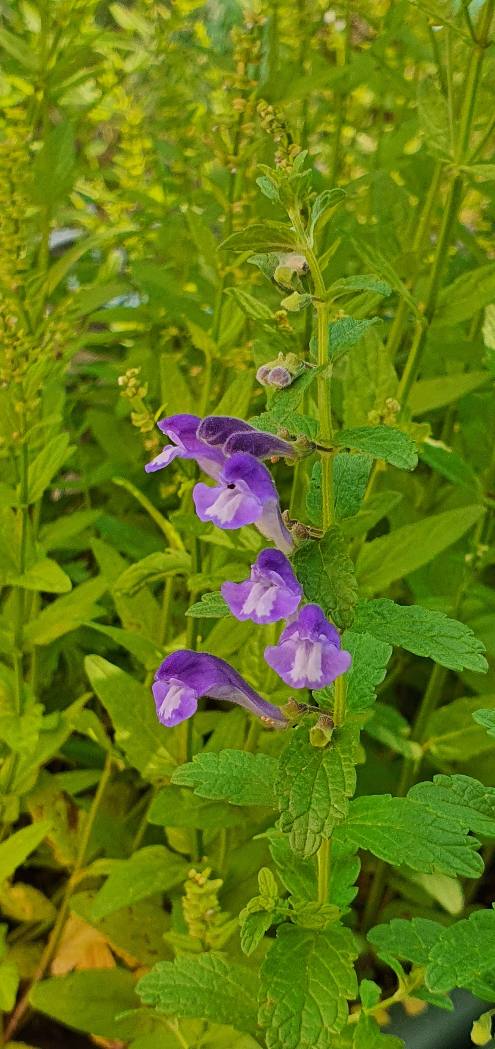
USP Proposal – Optimizing medicinal flavonoid accumulation in Scutellaria
10/6/2020

Slide 2
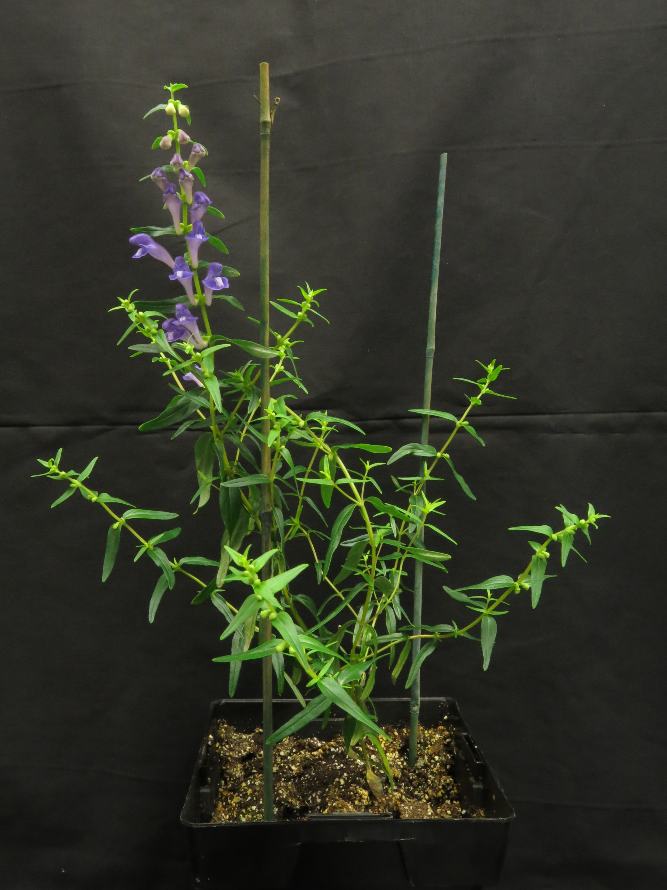
Background
Scutellaria genus contains multiple species used in traditional medicines
S. baicalensis
S. lateriflora
S. barbata
S. baicalensis is most well studied – accumulates high concentrations of unique flavonoids in roots
S. baicalensis

Slide 3
Background
4’-deoxyflavones are mostly unique to Scutellaria genus and have various bioactive effects
Methods of 4’-deoxyflavone mass production are limited
Harvesting indigenous plant populations
Chemical synthesis
Biotechnology
Flavonoid profiles for many Scutellaria species are unknown
Zhao et al., 2019

Slide 4
Goals
Determine alternative Scutellaria species for flavonoid mass production
S. leonardii
S. racemosa
S. suffretescens
S. wrightii
Determine optimal growing conditions needed to maximize flavonoid accumulation
UV light exposure
Drought/salt stress

Slide 5
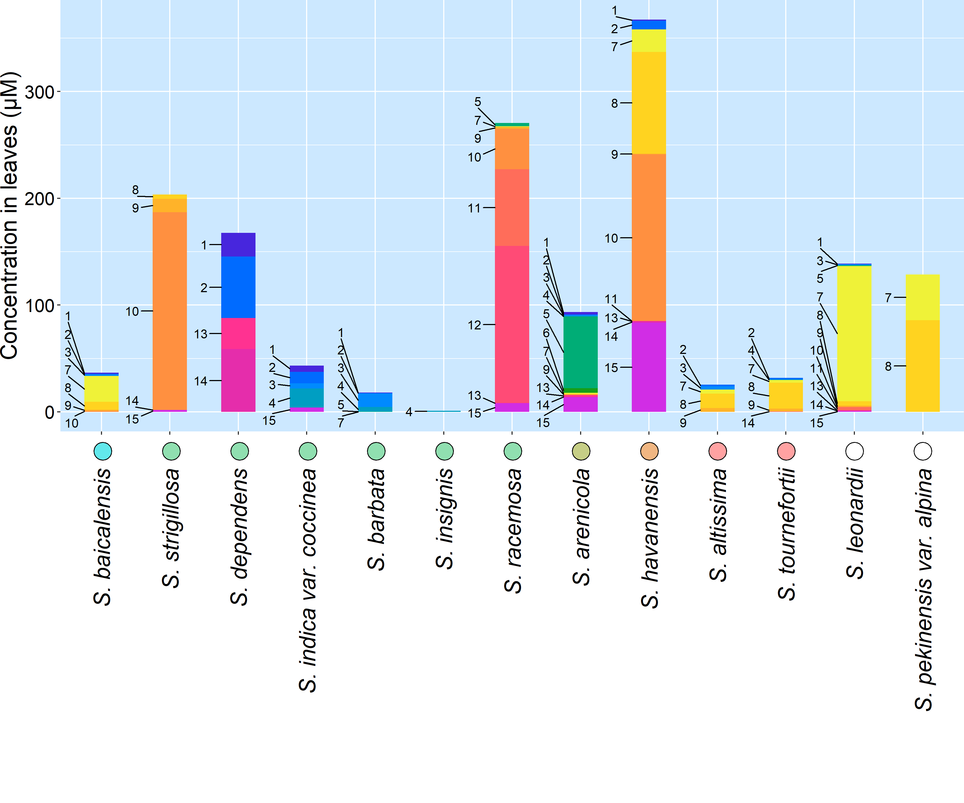
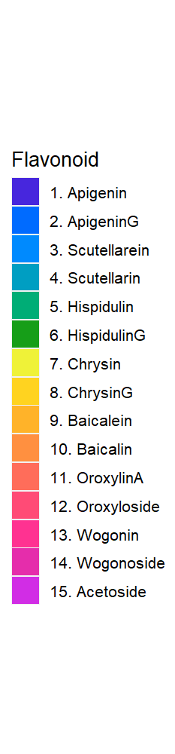
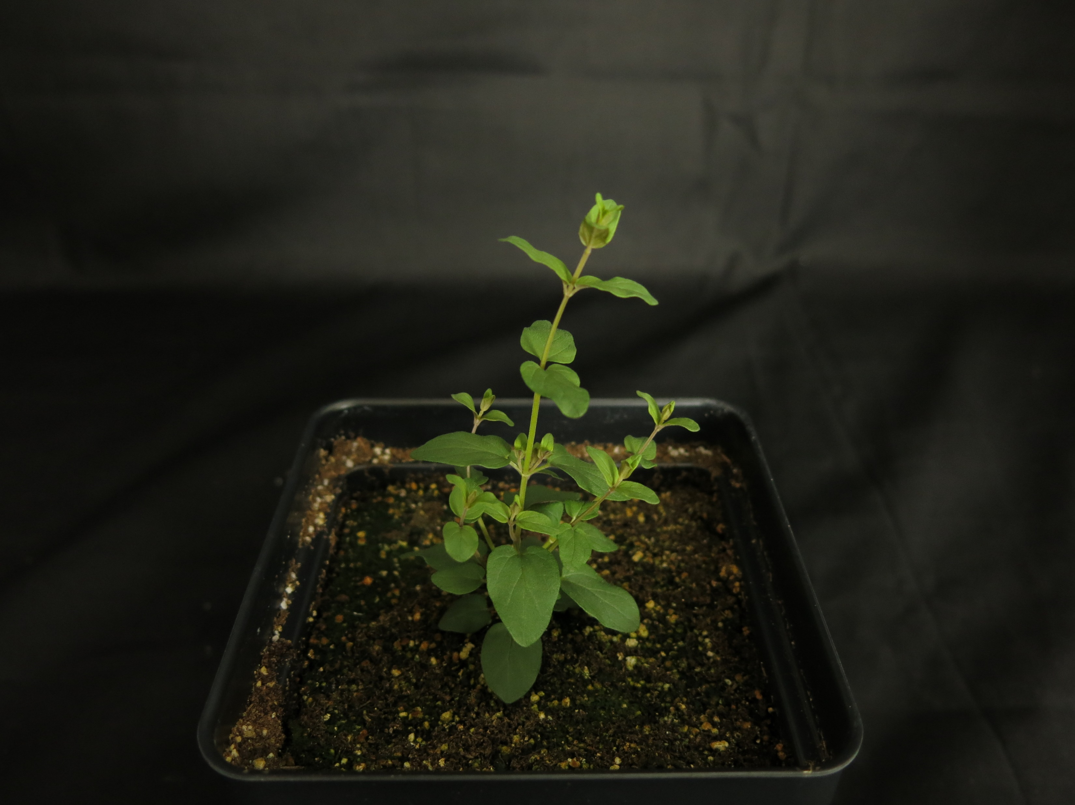
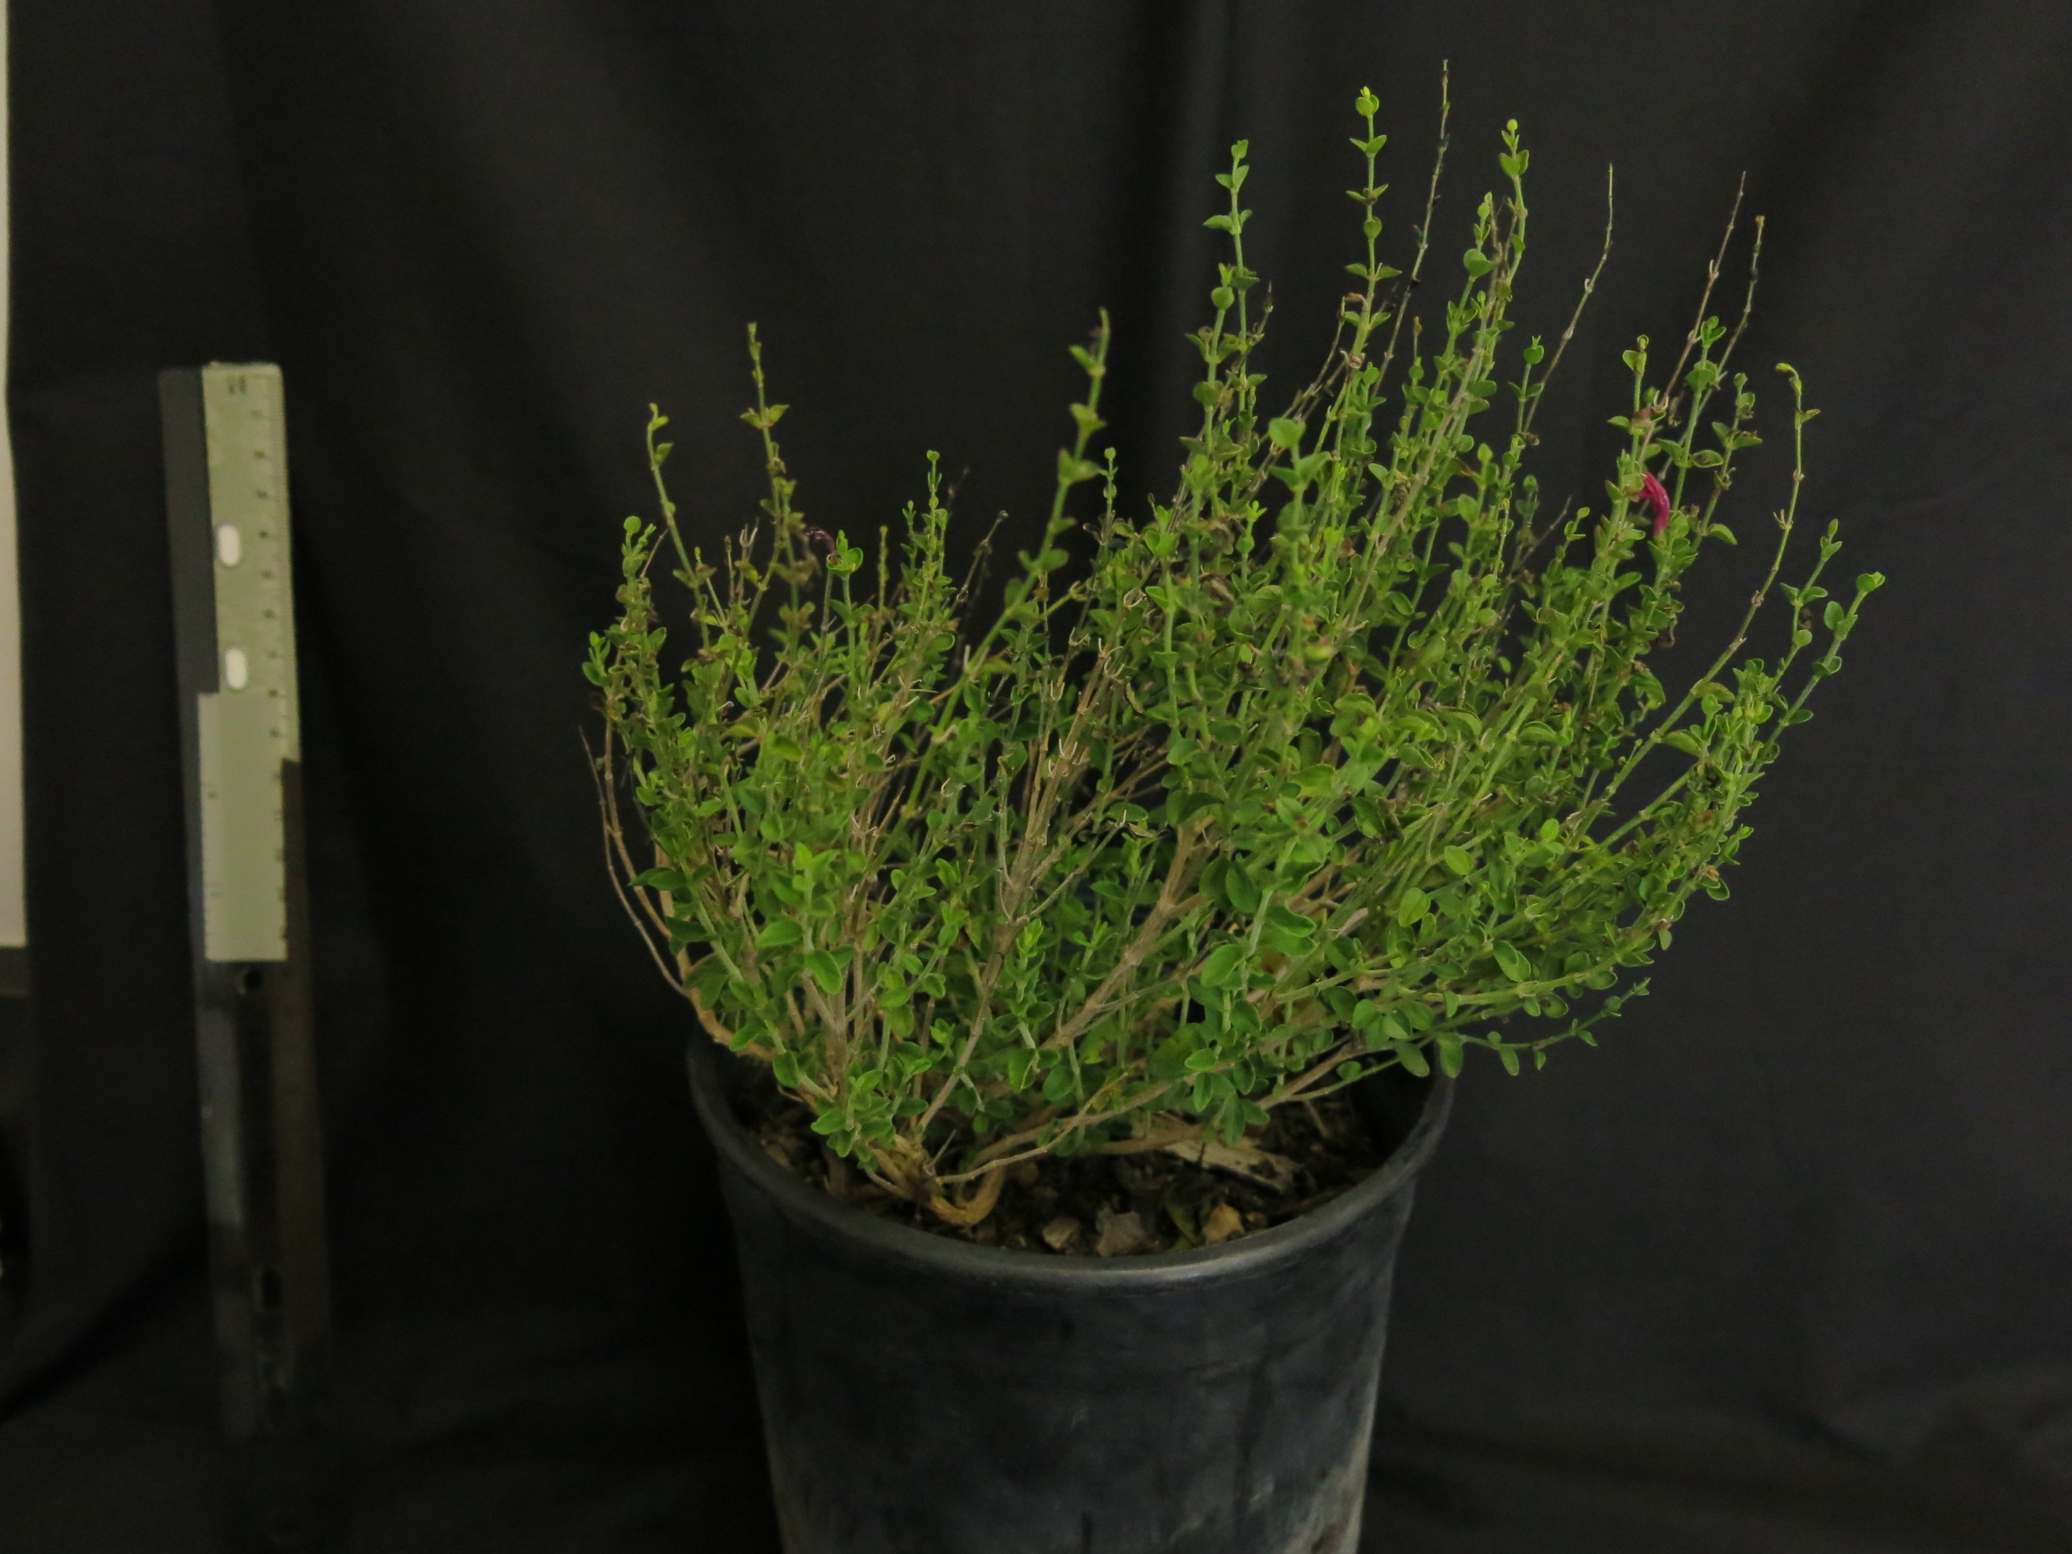
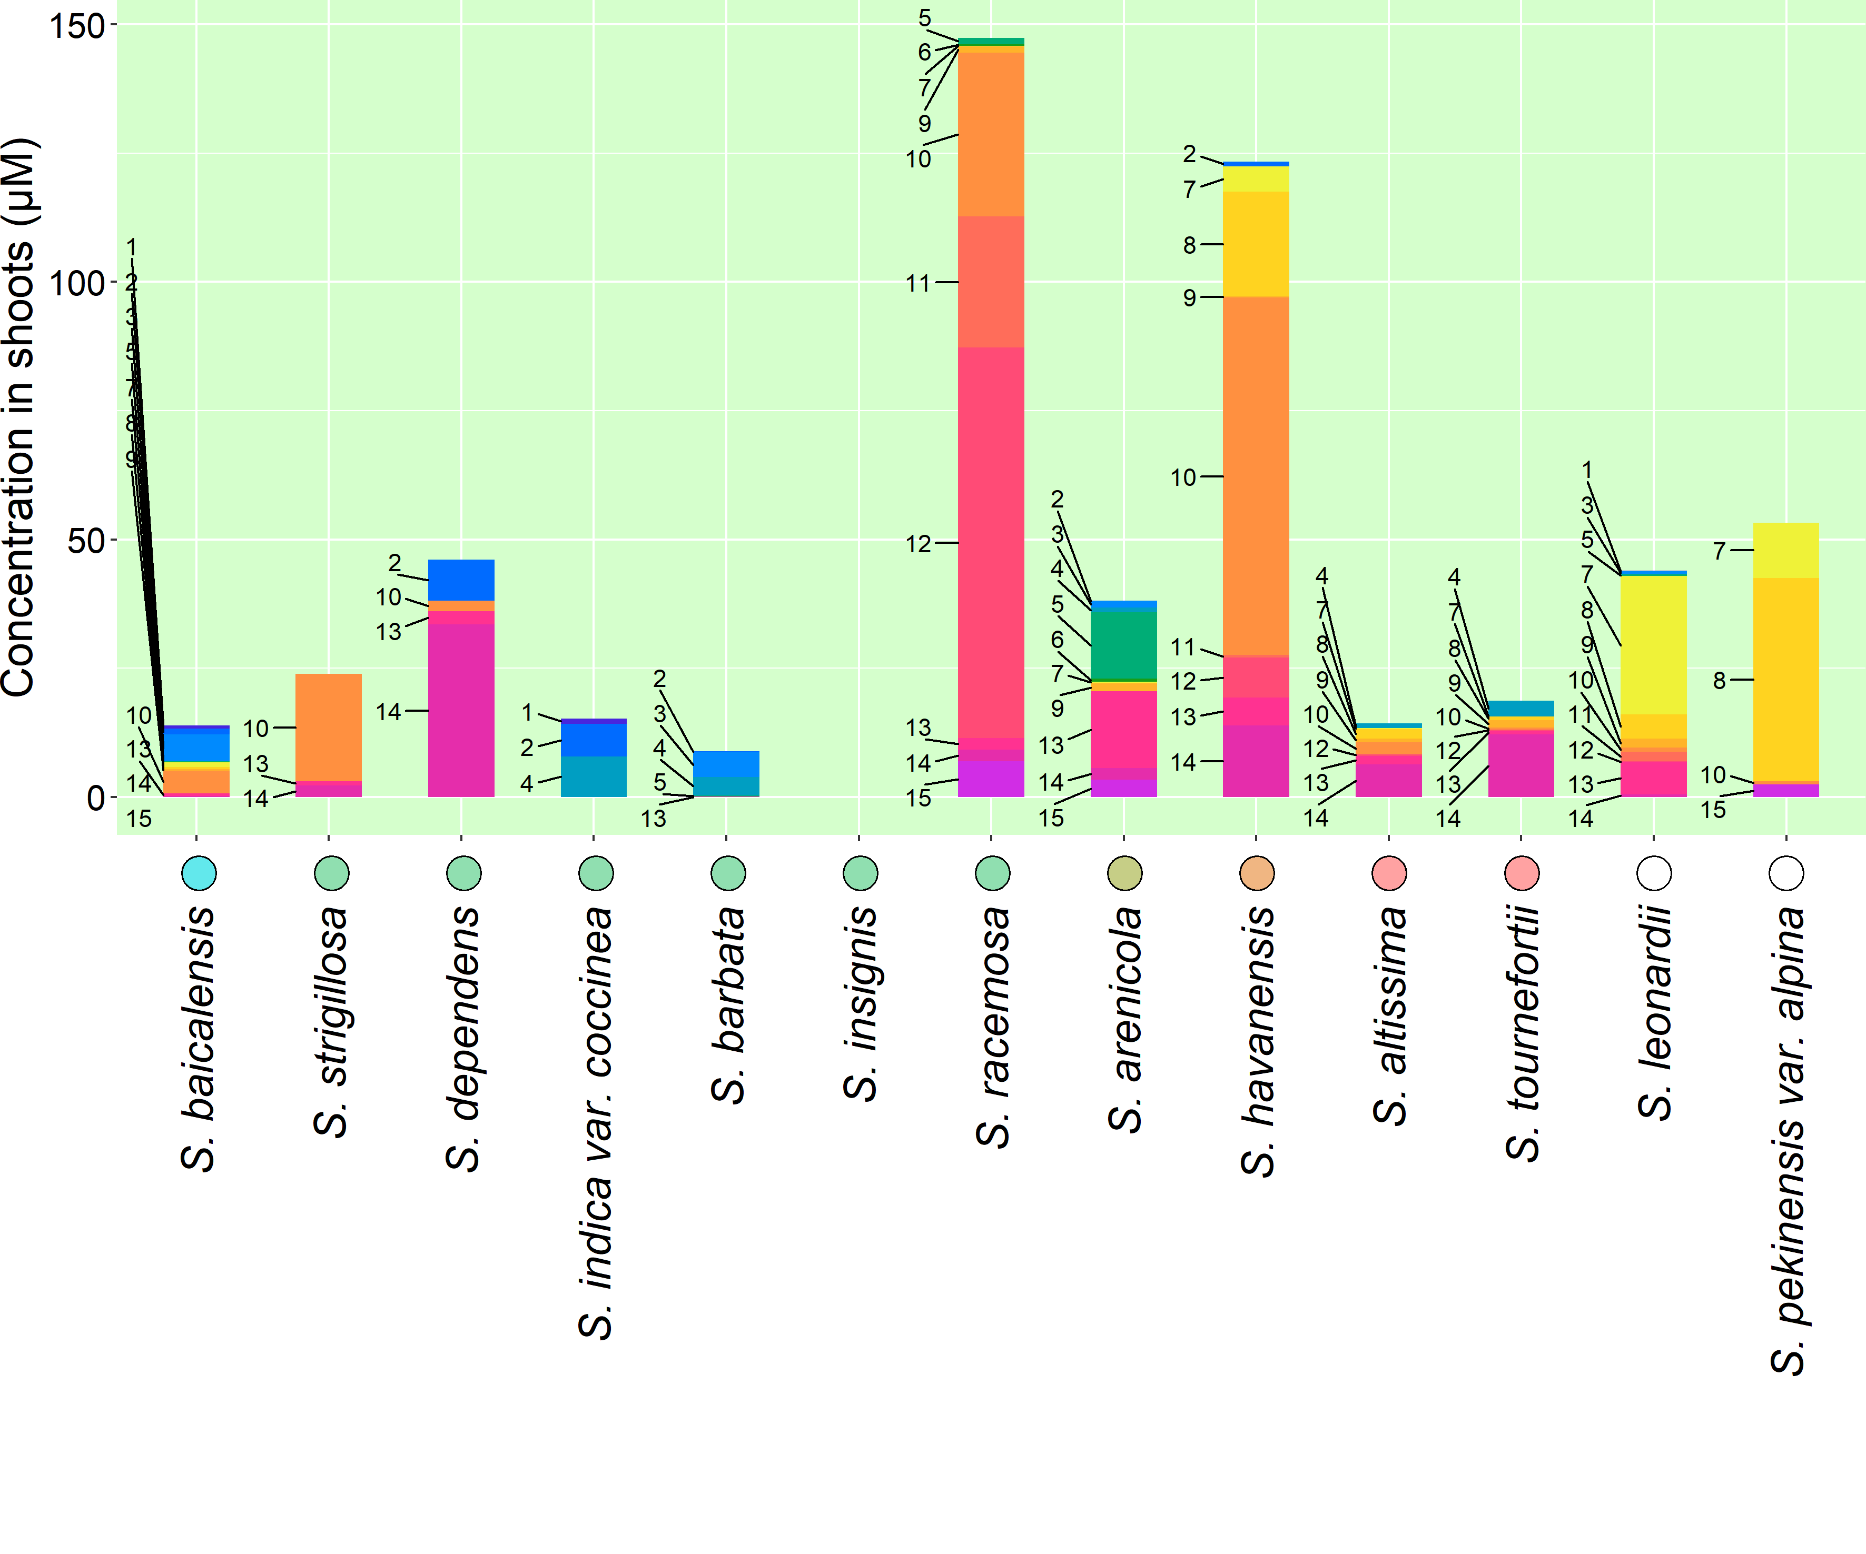
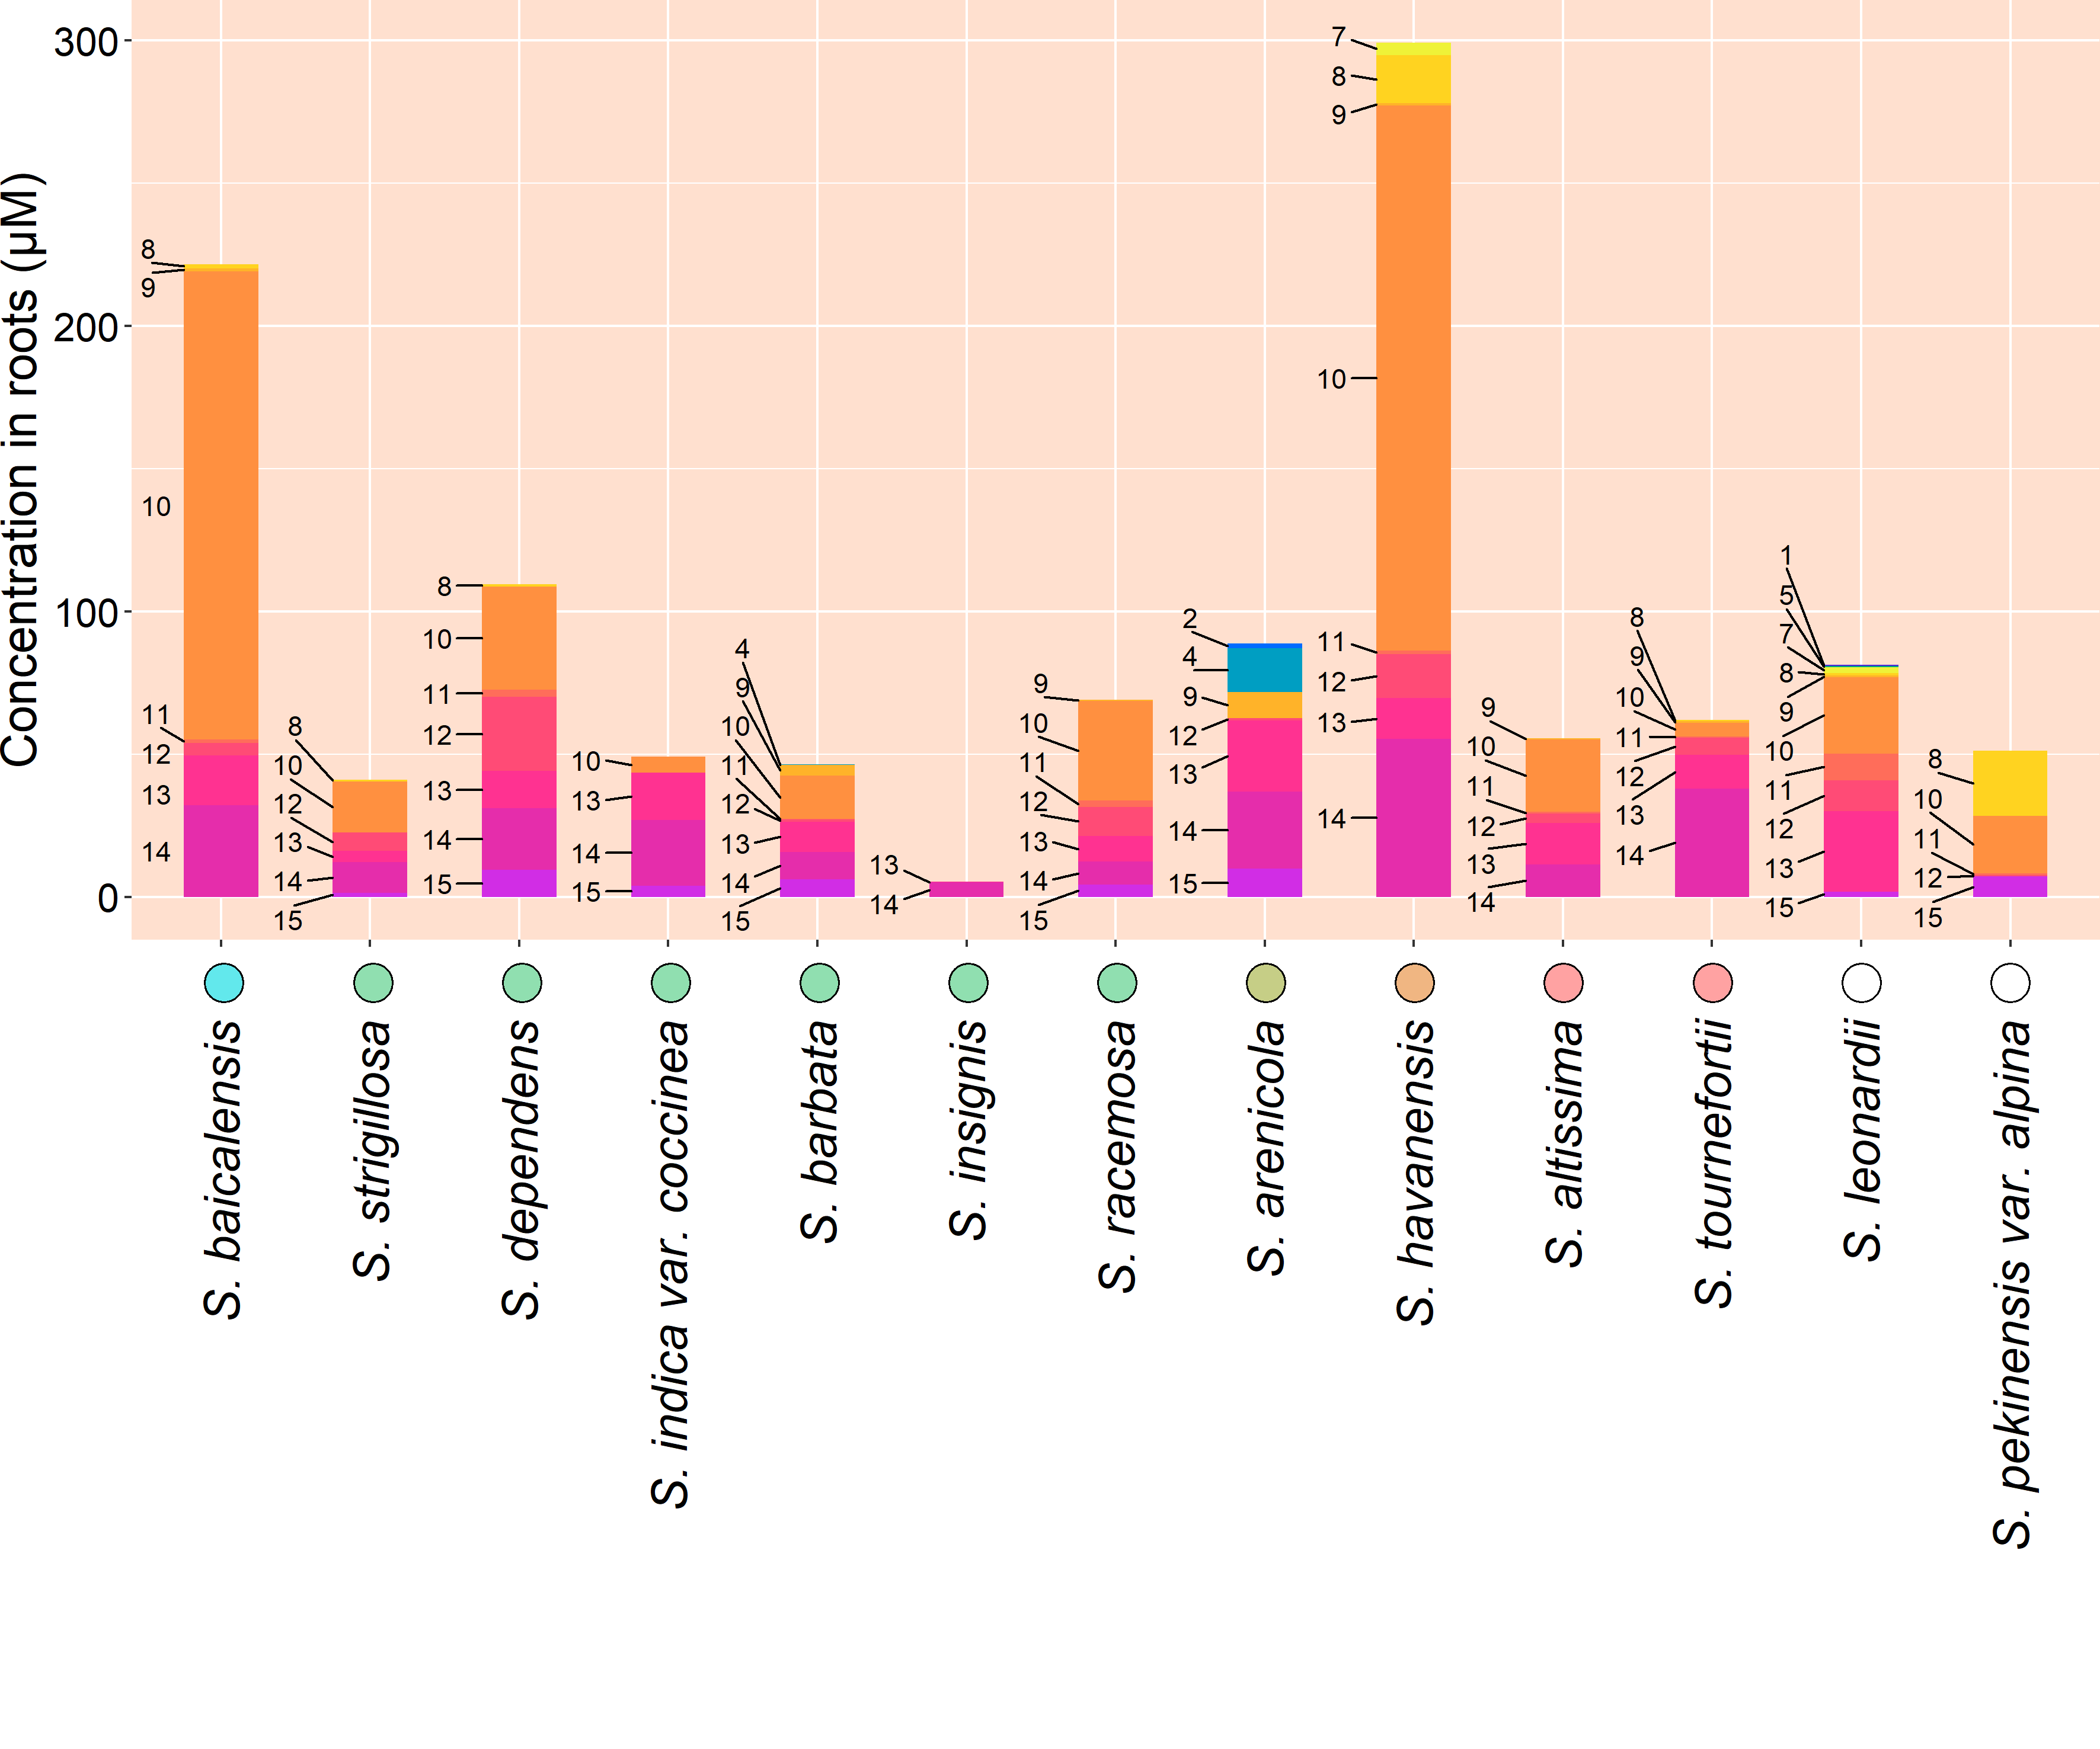
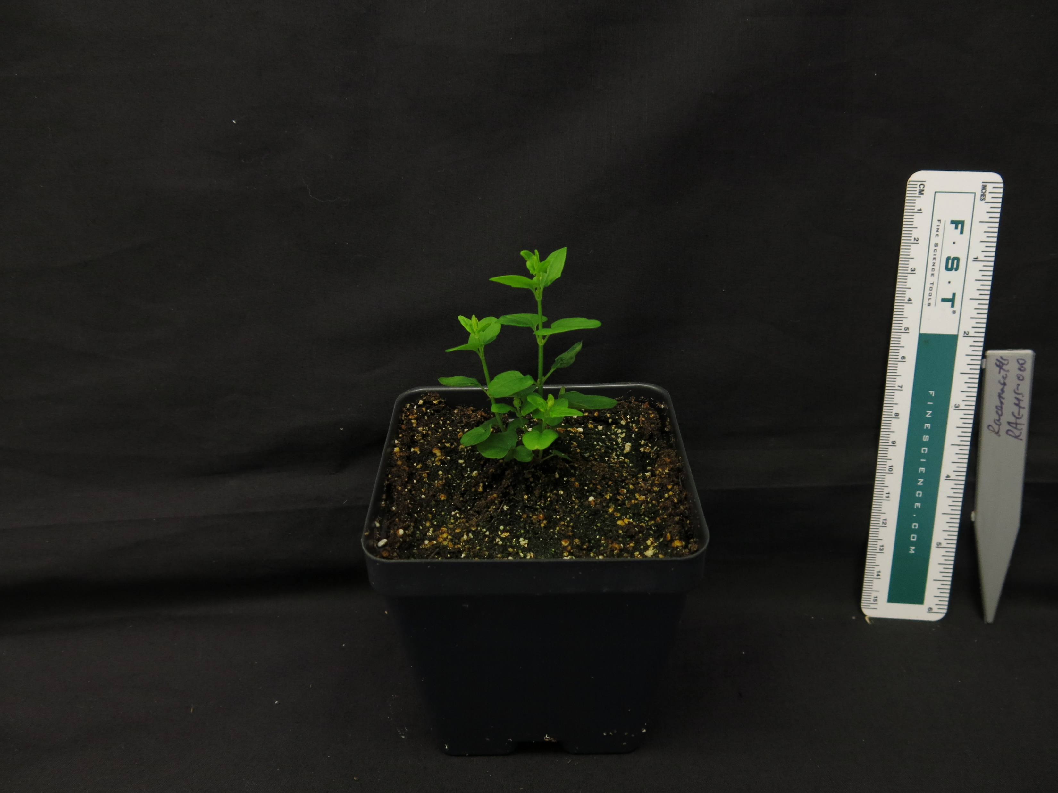
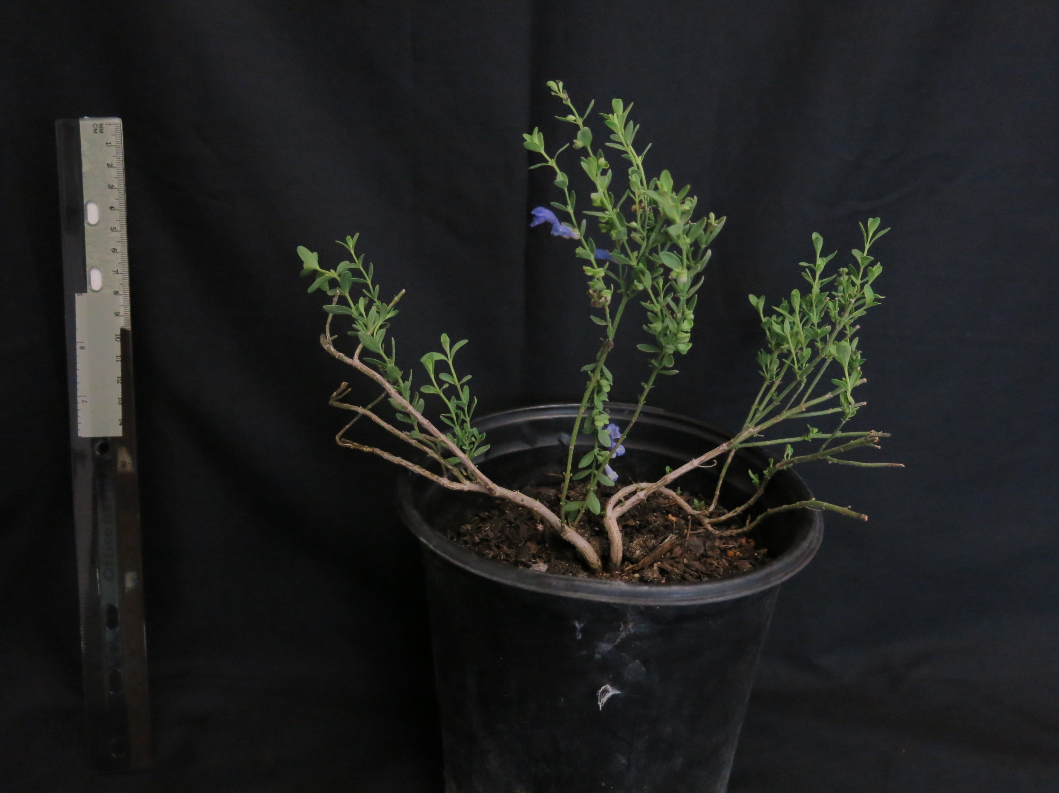
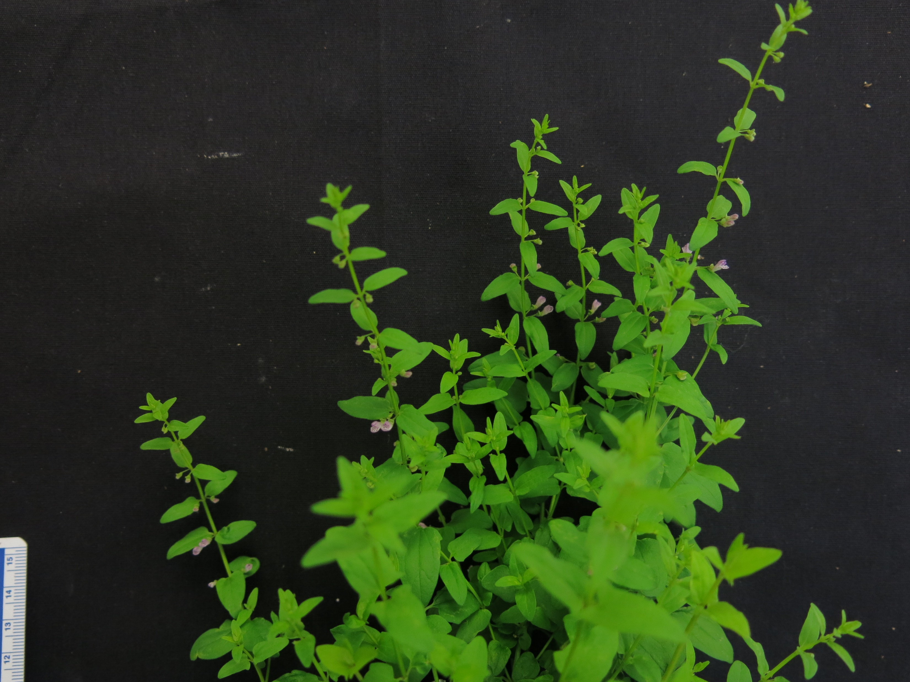
Species of interest
S. leonardii
S. suffretescens
S. racemosa
S. wrightii

Slide 6
Environmental variables
UV-B exposure
Drought stress
Polyethylene glycol (PEG) treatment
NaCl
Stress hormone treatment
Abscisic acid (ABA)
Jasmonic acid (JA)
Ethylene
Photoperiod – continuous light/dark
Other variables to consider – plant organ and growth stage

Slide 7
Overview of methods
Grow plants in soil, on solid media, or callus/root cultutre in liquid media
Expose to environmental stress
Harvest tissue from roots/shoots/leaves/flowers and extract flavonoids
Measure flavonoid concentrations in HPLC
Report promising species, and optimal growing conditions to maximize flavonoid accumulation

Slide 8
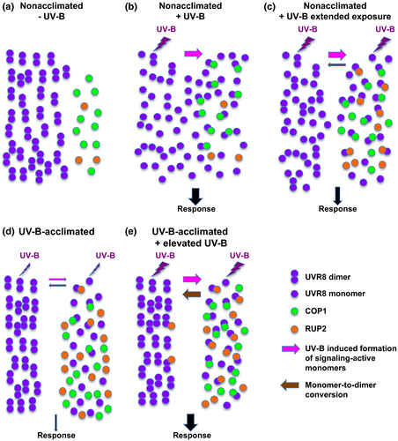
UV-B signaling
UVR8 signaling is repressed by a negative feedback loop with RUP2
Liao et al., 2020

Slide 9
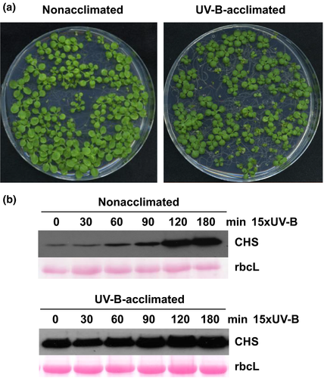
UV-B signaling
Determine if Scutellaria displays similar UV-B acclimation phenotype
Find UVR8 homolog in Scutellaria
Determine if UVR8-like transcription factor regulates flavonoid biosynthesis – ChIP-Seq, cis-element analysis
CoIP assay @ various times after UV-B exposure to find UVR8-like protein-protein interactions
Liao et al., 2020

Slide 10
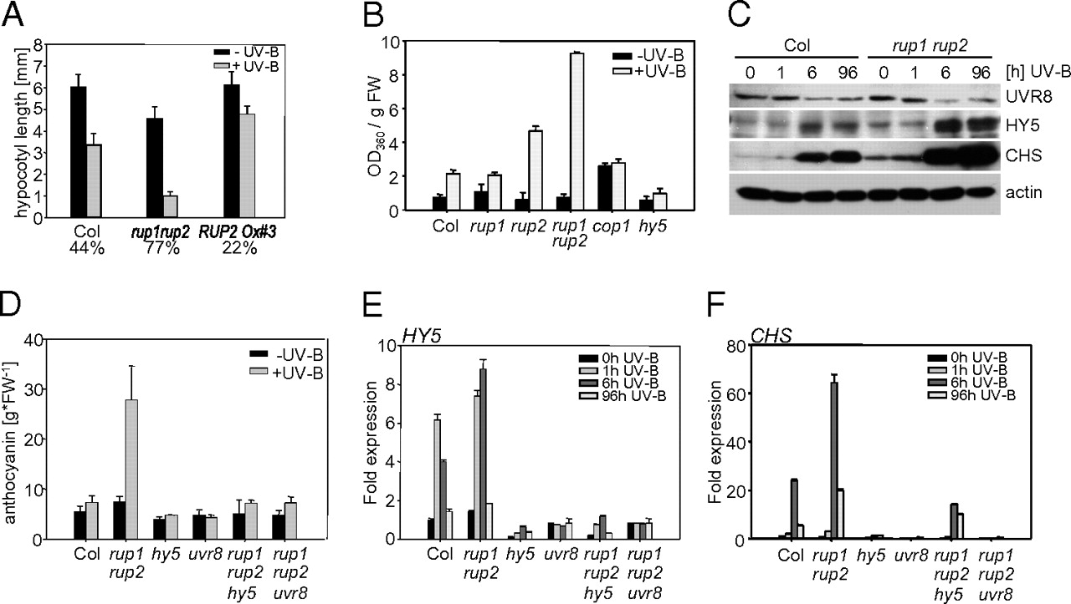
UV-B signaling
5. Identify RUP2 homolog and generate knockout line – flavonoid accumulation should be significantly upregulated
Gruber et al., 2010

